Slide 1
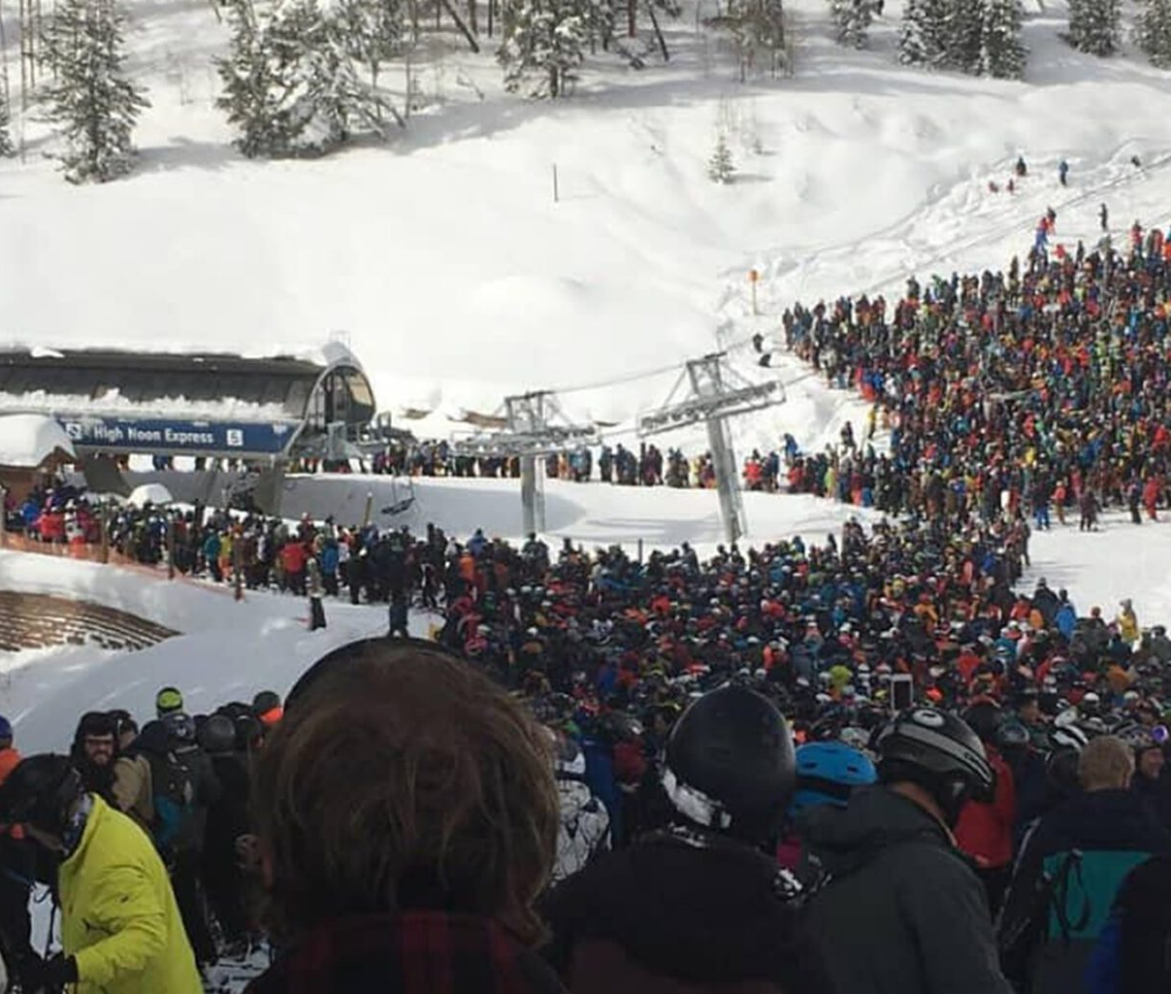
ShouldiSki

Slide 2

1. Introduction
ShouldiSki is an App developed for skiing. The app uses data from prominent hotel booking platforms and ski resort websites, offering users crowd information. Before you even consider checking your map, gauge the potential crowding, understand the prevailing weather, and get insights on ski track conditions, all through a mobile interface designed for on-the-go checks. Leveraging third-party libraries like Booking.com, this app provides skiers with accurate, consolidated information, free them from situation of short of exceptional.

Slide 3
2. Persona, Scenario and requirements
Emily, The Weekend Warrior
Age: 28
Occupation: Marketing Specialist
Technology Proficiency: High
Skiing Experience: Intermediate
Goals: Wants to make the most out of her short ski trips during the weekends.
Scenario: Emily plans her ski trips spontaneously, depending on her work schedule. She needs up-to-date information to make quick decisions.
David, The Family Man
Age: 35
Occupation: Software Engineer
Technology Proficiency: High
Skiing Experience: Beginner (Family trips)
Goals: Ensure a safe and enjoyable skiing experience for his wife and two young children.
Scenario: David plans his family ski trips months in advance. He needs to ensure the conditions are perfect for his family, especially his children.

Slide 4
Sarah, The Seasoned Skier
Age: 45
Occupation: Freelancer Photographer
Technology Proficiency: Moderate
Skiing Experience: Expert
Goals: Find less crowded slopes to practice and capture beautiful moments.
Scenario: Sarah is flexible with her time and goes skiing frequently. She’s looking for real-time crowd information and ski track conditions to find the perfect spot.

Slide 5
Must-Haves (MVP)
Real-time Crowd Index:
As a user, I want to view the real-time crowd index of ski resorts so that I can avoid crowded areas.
Related to: All Personas
Weather Information:
As a user, I need up-to-date weather information of the ski resort so that I can prepare accordingly.
Related to: Emily, David
Ski Track Conditions:
As a user, I want to check the current ski track conditions to ensure they are safe and match my skiing skill level.
Related to: David, Sarah

Slide 6
Want-to-Haves
Distance Calculator:
As a user, I want to know the distance from my current location
to the ski resort so that I can plan my travel time.
Related to: Emily, David
User Reviews and Ratings:
As a user, I want to see reviews and ratings of ski tracks from other skiers to get insights on their experiences.
Related to: Sarah, Emily
Nice-to-Haves
Personalized Recommendations:
As a user, I would like personalized recommendations for ski tracks based on my skill level and preferences.
Related to: Emily, Sarah
Social Sharing:
As a user, I want to share my skiing experiences and track conditions with my friends or on social media.
Related to: Sarah, Emily

Slide 7
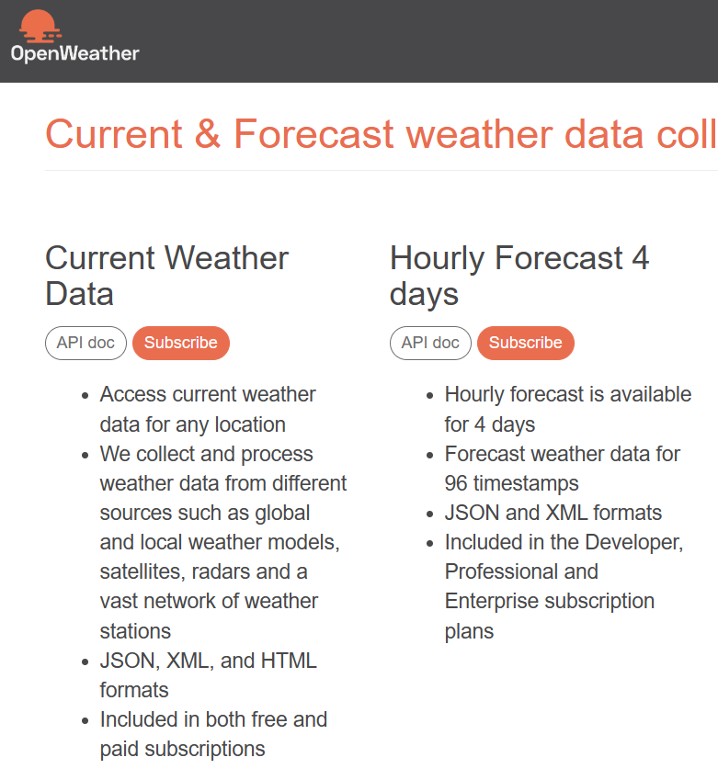
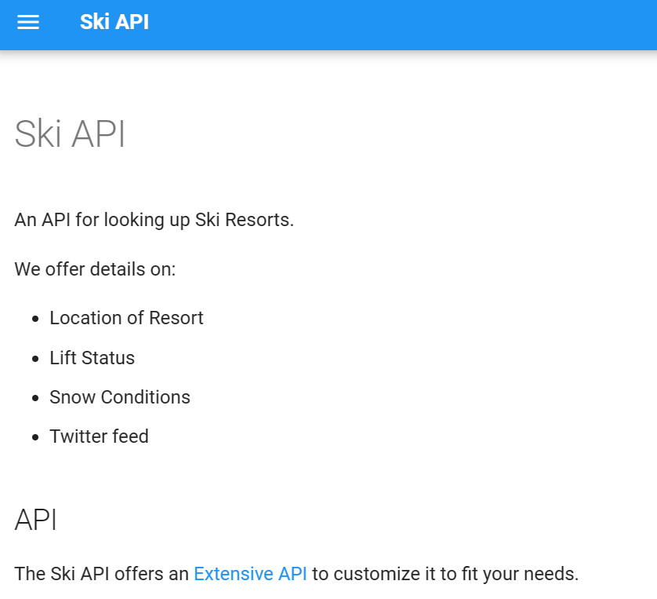
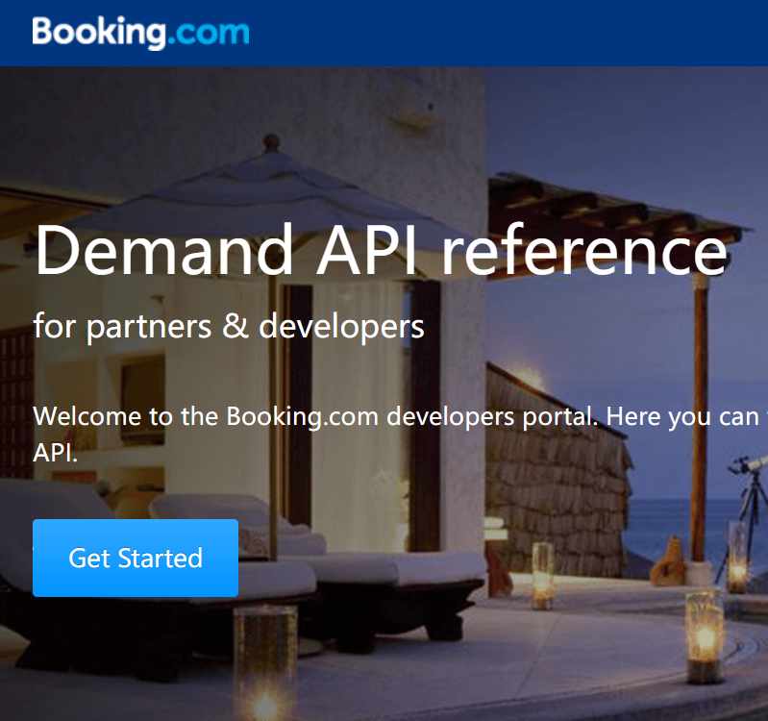
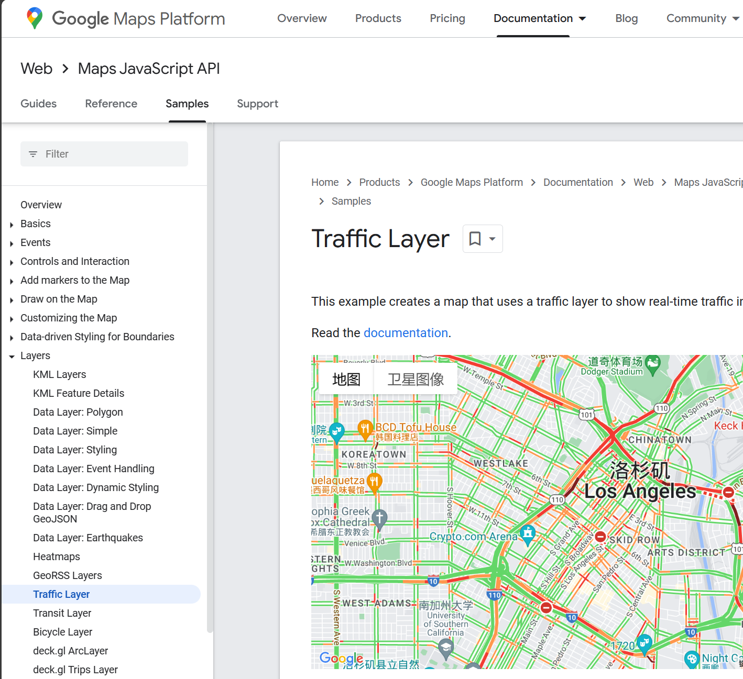
API Usage
OpenWeather – We will be using this API to get weather updates.
Ski API – The API provide ski track condition feedback. As well as other factors such as lift status, which we might use in the future updates
Booking.com – We use hotel reservation status API data as a key factor to evaluate crowd index.
Google Map Traffic – Traffic condition data will be used to generate traffic index.

Slide 8
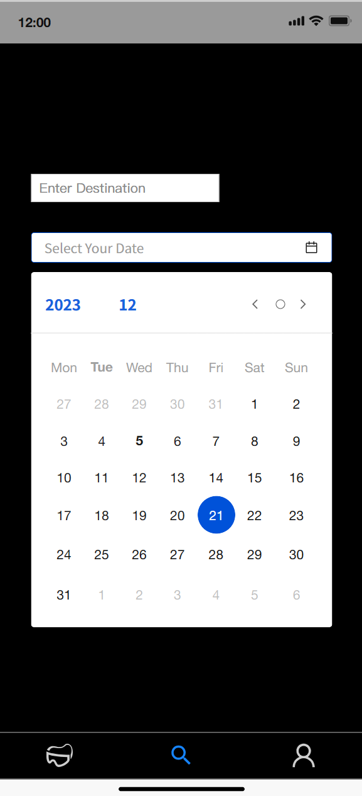
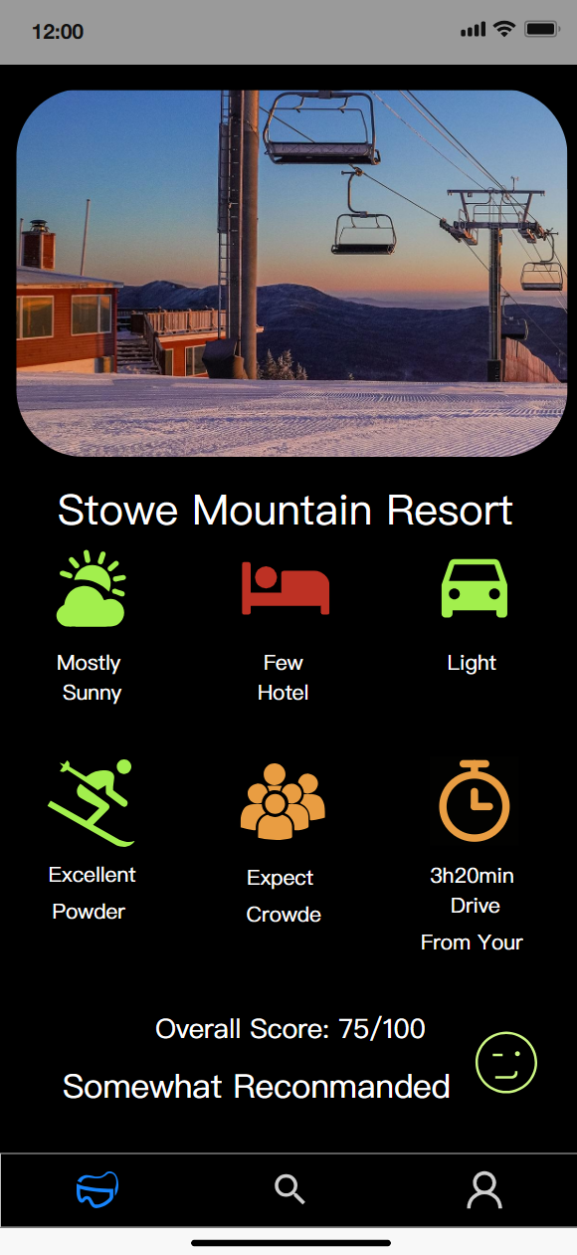
Architecture
UI Design
Search Page- User can enter their desired destination and date
Detail Page- after searching, the app switch to detail page and display the result with all indexes
Profile Page- User can modify their preference setting here.

Slide 9
Development risks API usage: Both of us don’t have much experience on API. It will be the biggest challenge for our time during the project. Data processing: After we acquire the data through APIs, What should we do with the data collected? Should we keep it in a database and preserve the data or is it a one-time usage to delete it every time finish using it?
How do we analyze the data? Each user has their own preference for judging, how do we meet this problem? Solutions API: We will use the divide and conquer strategy, each of us will be responsible for two API development. We planned for a period for us to study and familiarize on how we can use and deploy those APIs
Data Processing: It is a still debated question on how we will deal with the data since it is one of the core part of this project. For the MVP, we will use the simplest method to get every function working. In future updates and optimization, we will discuss more interactive and secure ways of using data.
Risk Analysis

Slide 10
Date | Plan | Date | Plan
10.5-10.19 | Project ideas | 11.24-11.26 | API learning Each team member will be responsible for 2 API development
10.20-11.2 | project proposal | 11.27-11.30 | API practice Each team member will be responsible for 2 API development
11.3-11.9 | APP structure design Group discussion | 12.1-12.7 | Implement API into project Each team member will be responsible for 2 API development
11.10-11.23 | APP Structural building: Establish every component except API Sicheng Chen: 1. Layout UI design 2. Code behind structure setup Siyi Du: 1. APP control logic 2. Data storage | 12.7-12.10 | Testing Sicheng Chen: JVM Test Siyi Du: Instrument Test
 |  | 12.10-12.16 | UI Update and other optimizations
Develop Plan

Slide 11
UI Design Tool : Modao https://modao.cc/brand
Booking.com API : https://developers.booking.com/api/index.html
Ski API : https://skiapi.com/
OpenWeather : https://openweathermap.org/api
Google Map API : https://developers.google.com/maps/documentation/javascript/examples/layer-traffic
Reference

